Slide 1
Welcome 2024-2025 WBL Students

Slide 2
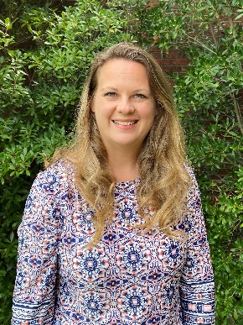
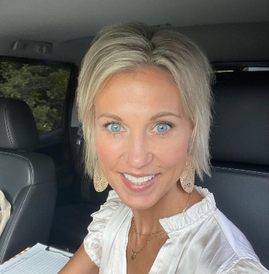
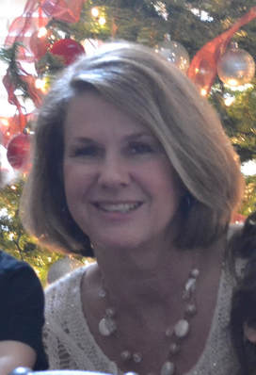
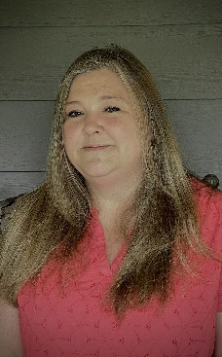
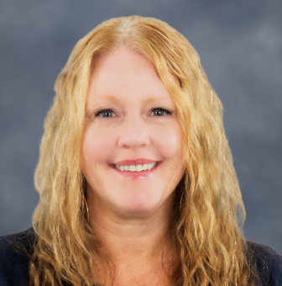
WBL Coordinator Information
Leon Bowers
EPHS
Lashonta Flemister
HHS
Michelle Miller
NPHS
Christi Dorsey
NPHS
Karen Parker
PCHS
Melissa Moody
SPHS
Monica Rydza
District Office

Slide 3
Goal of WBL (Student Handbook)
To develop or build upon employability skills such as learning positive work habits and attitudes. You will have the opportunity to learn from professionals in your career field and earn elective credit from the WBL course.
Notes:
Page 5

Slide 4
Placements
Placements in a family business are not appropriate
WBL students cannot be placed in a home office or private residence
WBL employers must have a business license and meet all legal requirements
Work sites must be free from discrimination or exploitation
Notes:
Page 5

Slide 5
Job Commitment
Maintaining employment is a requirement
Job changes must be approved by your WBL Coordinator and a two-week notice given to your employer
Changing jobs without approval grade is reduced to a 60 or below
Must notify coordinator within 48 hours if you are released from you job
Follow company procedures
Notes:
Page 5
Find out when I go to visit that a student has either been fired or quit.

Slide 6
Training Plan
Document explaining knowledge and skills learned throughout your job placement
The student, employer, and WBL Coordinator work together to create a specific list of tasks or skills to be learned on the job
Notes:
Page 5

Slide 7
Employer/Coordinator Evaluations
Summative grade each nine weeks from the employer and the coordinator
Based on GeorgiaBEST criteria for employability skills
Notes:
Page 5

Slide 8
Hour Requirements
Elective credits are earned for WBL
1 block of WBL=7.5 work hours per week
2 blocks of WBL=15 work hours per week
3 blocks of WBL= Must have approval
Notes:
Page 6

Slide 9
Attendance & Record Keeping
WBL attendance will be kept by signing in and out through your coordinator
Counts on the coordinator evaluation – consistency. Failure to do so is considered skipping and will result in a discipline referral
Your WBL Coordinator will give you details on when and where to sign in or out until you are fully released as a WBL student
Notes:
Page 6

Slide 10
Dual Enrollment Students
Student driven program
The responsibility is on you to keep up with assignments, dates, requirements, etc.
Notes:
Page 6

Slide 11
Meetings
Meetings (virtual or in person) are required
These count as a grade
All assignments are due on Canvas by posted due date
Time sheets are turned in on Canvas
WBL is NOT extra-curricular – you are earning school credit
Doctor and dentist appointments should not be made during your release time if you are scheduled to work
Notes:
Page 7

Slide 12
Time Sheets
Fill out completely with blue or black ink – neat, no rips, tears, etc.
Total weekly and monthly hours/amounts (round totals)
One month per time sheet - August ONLY
Only mentor or workplace designee can sign time sheet (must be on paperwork)
Due on Canvas by the due date
Notes:
Page 7
August time sheet due in September

Slide 13
Communication
WBL webpage is accessible through the PCSD
Canvas – career portfolio information, time sheets, meeting dates uploaded in WBL course
Remind – used to relay messages
Notes:
Page 7

Slide 14
Special Events
Required events in order to meet your WBL standards and earn your GeorgiaBEST certificate
Rising Professionals – TBA
Industry Tour - Optional
Employer Appreciation - Spring
Attendance and participation count as a grade and are like a field trip
Each one will cost approximately $10 and due 2 weeks before the event date
Notes:
Page 8

Slide 15
Student Behavior & Attitude
WBL students must follow all regulations and policies set by the Paulding County School District
WBL students are expected to excel in three major areas: academic performance, school/workplace behavior, and job performance
Failure to meet these goals can result in termination from the program and possible loss of credit
If assigned to ISS – must stay until the end of the school day – lose privilege of leaving early
Notes:
Page 8 – Mention Vaping – New consequences – 5 days OSS – will be removed from WBL

Slide 16
Items to remember:
If you do not attend school, you should not report to your job unless you have special permission from your WBL Coordinator
If you are sick and cannot attend work, you must call your employer before you are scheduled to begin work that day
Please schedule all doctor and dentist appointments outside of your work and school hours when possible
No show to work, not completing monthly assignments will result in removal from the program
Follow company procedures when you are going to be absent on a scheduled work day
Notes:
Page 9

Slide 17
Career Assignments Information
Career assignments are a state requirement for WBL
You are responsible for maintaining and submitting your monthly assignments on Canvas
You will be given these at the August meeting
Notes:
August assignment will be completed during the first days of school before you are approved to leave

Slide 18
TCSG (Technical College System of Georgia-GeorgiaBEST
Employability skills (employer statistics)
42% employers say employees lack soft skills
85% say soft skills were an issue at their company
Issues most concerning - attendance/punctuality, attitude/respect, discipline/character and mobile devices
76% say they would give preference to GeorgiaBEST certificate holder
Notes:
Assignments are based on GeorgiaBEST employability skills

Slide 19
Grading Policy
All assignments must be turned by posted due date
For partial credit, portfolio assignments can be turned in within 5 days of the due date
Details in grading rubric
Notes:
Page 10

Slide 20
Employer Paperwork
Due August 1, and must contain all required signatures
Cannot report to school late or leave early until complete and checked off by WBL Coordinator
Contact your coordinator to turn in Open House or at an earlier date
Look closely at provided checklist
Notes:
Time Sheets – see example for completion – do not turn in a wrinkled, damaged sheet – redo it before it is due
PARENTS DO NOT COMPLETE – THIS IS A SUMMATIVE GRADE
Students complete neatly – I must be able to read the numbers, names, etc.
If a blank does not apply – put a “dash”
You must answer all blanks – the only ones that won’t apply would be a home phone or perhaps a parent email, etc.
Bottom of STUDENT-WORK INFO SHEET – MUST HAVE SIGNATURES AND PRINTED NAMES OF ANYONE WHO IS AUTHORIZED TO SIGN YOUR PAPERWORK
INTERNSHIP/VOLUNTEER – IF YOU ARE PAID – PUT AN X THROUGH THE TOP PART – EVERYONE MUST COMPLETE THE BOTTOM

Slide 21
Safety Sheet
Due your first DLD
Checklist
OSHA
Child Labor Summary Sheet (provided)
Dress Code
Harassment

Slide 22
“See Something, Say Something”
Arriving/leaving during odd times
“See anything” unusual, “say something”
Report to office personnel or administration

Slide 23
WBL Graduation Cord
Cord sheets given at August meeting
Opportunity to go above and beyond
Approved Community Service
May have cost associated with cord
Must meet coordinator’s deadline to earn cord

Slide 24
Work-Based Learning
1st Day of School – Monday, August 1
Check Remind for first day procedures
WBL Coordinators will be checking paperwork
Do not schedule work until after 4:00 until you have turned in all required documents and have permission to leave
What to do on advisement/testing days
Pay attention to school calendar
Advance notice to employer
Notes:
Set up OpenTime Clock, REMIND, work on August assignment

Slide 25
Please Remember!
Contact your WBL coordinator with any questions
You CANNOT be on campus during your WBL block unless your placement is at your school
Join Remind – can send private message, if sent after 9pm, will be answered the following day
Looking forward to a great year!

